Slide 1






AirLift A Fast and Comprehensive Technique for Remapping Alignments between Reference Genomes
Jeremie S. Kim*, Can Firtina*, Meryem Banu Cavlak, Damla Senol Cali,
Nastaran Hajinazar, Mohammed Alser, Can Alkan, and Onur Mutlu
bioRxiv Preprint
Source Code
Notes:
Hi everyone. I am Can. I am a PhD student in the SAFARI Research Group led by Prof. Onur Mutlu at ETH Zurich.
Today, I will be presenting our work, AirLift ...,
This work was co-lead by Jeremie and me.

Slide 2
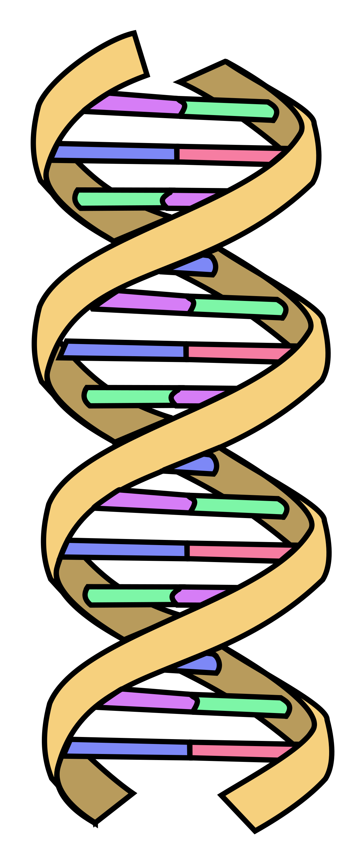
Genome Analysis
Genome analysis is critical for many applications
Personalized medicine
Outbreak tracing
Evolutionary studies
Genome sequencing machines extract smaller fragments of the original DNA sequence, known as reads
AAGCTTCCATGG
AAATGGGCTTTC
Reads
GCTTCCAGAATG
GCCCAAATGGTT
Notes:
Genome analysis is critical for many applications [CLICK]
Genome sequencing machines extract smaller fragments of the original
DNA sequence, [CLICK]
known as reads.
These reads do not contain the information about their location in their corresponding genomes.

Slide 3
Reference Genomes
Reference genomes play a crucial role in genome analysis for
Accurately mapping reads to potential matching locations in the genome
Identifying genomic differences in an individual’s genome
Reference Genome
…GCCCATATGGTTAAGCTTCCATGGAAATGGGCTTTCGCTTCCACAATG…
Differences
Differences
GCTTCCAGAATG
AAGCTTCCATGG
Reference genomes should provide an accurate and complete representation of a species to enable accurate analysis in the later steps of genome analysis:
Variant calling
Gene annotation and enrichment
AAATGGGCTTTC
GCCCAAATGGTT
Notes:
Reference genomes play a crucial role in genome analysis for [CLICK]
finding these locations of reads in the genome [CLICK]
and identifying the genomic differences in an individual's genome [CLICK]
To enable accurate analysis in the later steps of genome analysis such as variant calling, reference genomes should be accurate and complete [CLICK]

Slide 4
Updating the Reference Genomes
Reference genomes are updated regularly to
Correct the errors in the older versions
Fill in the missing genomic sequences
Unmapped Reads
AAATGGGCTTTC
AAGCTTCCATGG
Old Reference Genome
…GCCCATATCCAAAAGCTTC
??????
AATGGGCTTAACCTTCCACAATG…
GCCCAAATGGTT
GCTTCCAGAATG
New (updated) Reference Genome
…GCCCATATGGTTAAGCTTCCATGGAAATGGGCTTTCGCTTCCACAATG…
Remapping the reads to the updated reference genome can generate novel information due to
More accurately identified genomic differences
New reads mapped to updated or completed regions
Notes:
However, reference genomes are not perfect. They can contain errors and there can be many unknown regions in the reference genome [CLICK]
That's why reference genomes are updated regularly to their new versions to [CLICK]
correct the errors in the old version and [CLICK]
fill in the missing genomic regions [CLICK]
Whenever there is a new version of the reference genome, remapping the reads from old reference genome to the new one can generate novel information as [CLICK]
genomic differences can be identified more accurately and [CLICK]
any reads that were unmapped to the old reference genome [CLICK]
can be mapped using the new reference genome [CLICK]

Slide 5
Changes between Reference Genomes
Retired Regions
Removed from the new reference genome
New Regions
Added to the new reference genome
Constant Regions
Exactly the same sequences
Positions may change
Updated Regions
Mostly the same sequences with small changes
Notes:
This figure shows four main types of changes there can exist between an old and a new reference genome. [CLICK]
Some regions of the old reference genome are completely removed from the new reference genome. We call these regions retired regions. [CLICK]
The new reference genome can insert novel sequences that were missing from the old reference genome. [CLICK]
Some regions between these two reference genomes will remain unchanged in terms of the sequence content [CLICK]
However, their positions may still be shifted due to the deletions and insertions in the new reference genome [CLICK]
And there are some regions that include slight modifications such as a few substitutions [CLICK]

Slide 6
Existing Solutions for Remapping Reads
1
Map all the reads from scratch
2
Move the mapping locations
Notes:
There are mainly two solutions that can remap reads from an old reference genome to the new one [CLICK]
The first solution is to map all the reads from scratch using a read mapping tool [CLICK]
The second solution is moving the mapping locations without using read mapping [CLICK]

Slide 7
Existing Solutions for Remapping Reads
1
Map all the reads from scratch
2
Move the mapping locations
Notes:
Let's look at the first solution [CLICK]

Slide 8


Mapping Reads from Scratch
Mapped Reads
Unmapped Reads
Read Mapping
✓
Accurate mapping
Significant computation overhead
Notes:
When mapping reads from scratch [CLICK]
All the previously mapped reads [CLICK]
As well as any reads that are unmapped to the old reference genome [CLICK]
Are used to fully map them to the new reference genome. [CLICK]
This approach provides a very accurate remapping [CLICK]
With the cost of significant computation overhead [CLICK]

Slide 9
Mapping Reads from Scratch
A large portion of the reference genome remains unchanged (constant regions)
Entire Reference Genome
12%
Changed Content
Identifying the differences for reads in the constant regions is redundant
Notes:
This is because, read mapping maps reads to the entire reference genome [CLICK]
However, only a small portion requires remapping while a large portion remains unchanged between old and new reference genomes. [CLICK]
Remapping reads from scratch wastes a lot of computation due to the redundant read mapping on the unchanged regions. [CLICK]

Slide 10
Existing Solutions for Remapping Reads
1
Map all the reads from scratch
2
Move the mapping locations
Notes:
This was the first solution for remapping reads [CLICK]

Slide 11
Existing Solutions for Remapping Reads
1
Map all the reads from scratch
2
Move the mapping locations
Notes:
Let's look at the second solution that moves the mapping locations without read mapping

Slide 12
Moving the Mapping Locations
Mapped Reads
Move Locations
✓
Minimal computation overhead
Inaccurate Mapping
Notes:
We can avoid the redundant mapping of reads by moving them [CLICK]
to their corresponding regions in the new reference genome [CLICK]
Such a moving updates only the position information of the mapped reads according to where constant and updated regions appear in the new reference genome. [CLICK]
By doing this, the reads are remapped with minimal computation overhead [CLICK]
However, it generates inaccurate mapping due to the erroneous moving in the retired, new, and updated regions. [CLICK]

Slide 13
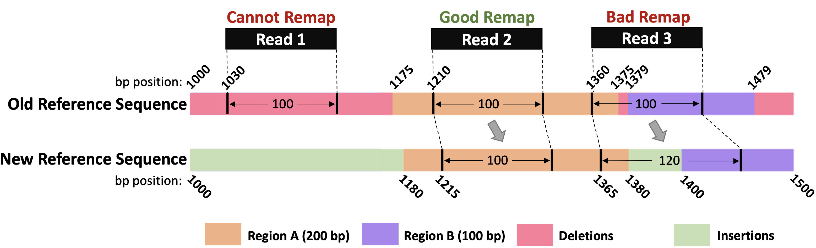
Moving the Mapping Locations
Cannot Remap: Reads in the deleted regions are not remapped
Bad Remap: Reads in the updated regions may map other regions better
A large portion of the mapping information is lost or inaccurate
Notes:
The inaccurate mapping is mainly caused due to two reasons. [CLICK]
First, the reads under the retired regions cannot be remapped [CLICK]
Second, the reads under the updated regions may cause bad remapping as these reads may now be mapped to another region in the new reference genome due to the changes that the updated regions contain. [CLICK]
We observe that a large portion of the mapping information is lost or inaccurate when moving the mapping locations. [CLICK]

Slide 14
Outline
Background
Motivation and Goal
Experimental Methodology
Temperature Analysis
Aggressor Row Active Time Analysis
Spatial Variation Analysis
Implications on Attacks and Defenses
Conclusions
Goal and Key Idea
AirLift
Evaluation
Conclusions
Notes:
Let's move to the goal and key idea of our work

Slide 15
Our Goal
Accurately and quickly remap all reads
by either mapping or moving them
from the old reference genome
to the new reference genome
Notes:
Our goal in this work is to ...

Slide 16



Avoids redundant read mapping
for the constant regions
Quickly identifies and maps the reads
that cannot be accurately moved
Notes:
Towards this we propose AirLift, which is based on two key ideas.
[CLICK] AirLift …
[CLICK] and …

Slide 17
Outline
Background
Motivation and Goal
Experimental Methodology
Temperature Analysis
Aggressor Row Active Time Analysis
Spatial Variation Analysis
Implications on Attacks and Defenses
Conclusions
Goal and Key Idea
AirLift
Evaluation
Conclusions
Notes:
I will now describe our work

Slide 18
AirLift Overview
Mapped Reads
Unmapped Reads
AirLift
✓
Low computation overhead
✓
Accurate Mapping
Notes:
This is the overview of AirLift. [CLICK]
In high level, AirLift takes all the mapped reads in the old reference genome [CLICK]
As well as any unmapped reads
[CLICK] and fully remaps them to the new reference genome
[CLICK] With low computation overhead
[CLICK] And accurate remapping

Slide 19
AirLift
AirLift Indexing (Offline)
AirLift Mapping
Notes:
AirLift has two main steps, which are
AirLift indexing
and AirLift mapping

Slide 20
AirLift
AirLift Indexing (Offline)
AirLift Mapping
Notes:
I will now explain the indexing step

Slide 21
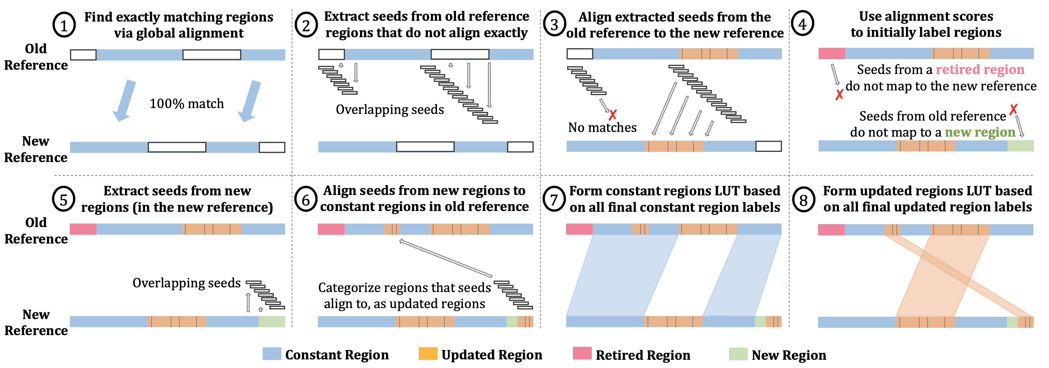
AirLift Indexing (Offline)
Notes:
AirLift indexing is a one-time task that needs to be completed once when a reference genome is updated.
The goal of indexing is to accurately identify all changes between an old and a new reference genome which are retired, new, updated, and constant regions.
The indexing contains 8 steps. I will now explain each of them briefly. [CLICK]

Slide 22
AirLift Indexing (Offline)
Notes:
The first step performs global alignment between two reference genomes to identify exact matches, which are labeled as constant reginos
[CLICK] Then we extract read-length subsequences, or seeds, from the remaining regions of the old reference genome that are not exactly matching and align them to the new reference genome.
[CLICK] Whenever these seeds can be aligned, the aligned regions correspond to the updated regions as they show high degree of similarity although they do not exactly match in the first step
[CLICK] The regions without an alignment to the new reference genome is considered retired regions as we cannot find a good alignment
And similarly the regions where no seeds are aligned in the new reference genome is considered new region
[CLICK] However, these new regions can still share high similarity in the constant regions of the old reference genome and the reads under these constant regions can be mapped better to these new regions
[CLICK] To identify such regions, we align the seeds from the new region to constant regions in the old reference genome. The aligned portions are also labeled as updated regions.
[CLICK] Based on these alignment results constant and
[CLICK] updated regions can now be accurately identified [CLICK]

Slide 23
AirLift
AirLift Indexing (Offline)
AirLift Remapping
Notes:
Let's look at the second step in AirLift which is the remapping step

Slide 24
AirLift Remapping
Mapped Reads
Unmapped Reads
AirLift
Quickly move reads in the constant regions
Remap reads in the updated regions
Remap retired and unmapped reads
Notes:
In the remapping step [CLICK]
AirLift utilizes the indexing information it generates in the first step to remap the reads to the new reference genome in several steps
[CLICK] First, reads in the constant regions are moved without read mapping
[CLICK] Then, reads under the updated regions are mapped. These reads can be mapped to the similar regions in their old reference genome
[CLICK] or mapped to a new region
[CLICK] or a different location in the updated region
[CLICK] Last all the reads in the retired region and
[CLICK] unmapped reads are fully mapped

Slide 25
AirLift Remapping
AirLift fully utilizes all reads
by either moving or remapping them
✓
AirLift generates an accurate
alignment file (BAM) that can easily be used
in downstream analysis
✓

Slide 26
Outline
Background
Motivation and Goal
Experimental Methodology
Temperature Analysis
Aggressor Row Active Time Analysis
Spatial Variation Analysis
Implications on Attacks and Defenses
Conclusions
Goal and Key Idea
AirLift
Evaluation
Conclusions

Slide 27
Evaluation Methodology
Remapping
Baseline: Fully mapping all reads
CrossMap remapper that can generate alignment files (BAM)
LiftOver remapper that generates only the updated positions
Accuracy: Variant calling using AirLift and full mapping
Datasets
Human (hg): Oldest: HG16 Newest: HG38 (5 versions)
Worm (ce): Oldest: ce2 Newest: ce11 (5 versions)
Yeast (sacCer): Oldest: sacCer1 Newest: sacCer3 (3 versions)

Slide 28
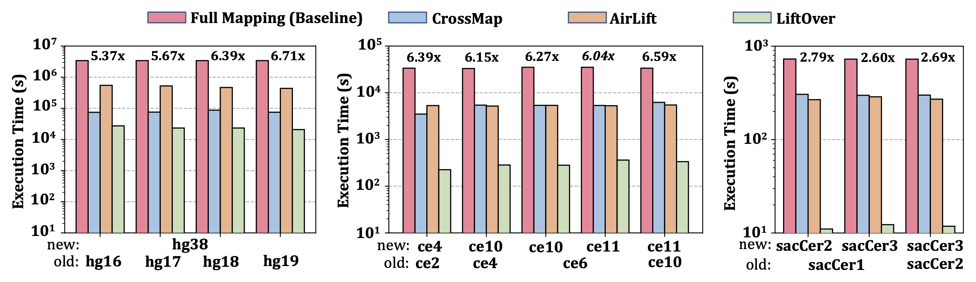
Performance
2.6× – 6.7× speedup compared to the full mapping
More comprehensive mapping:
Longer execution times than CrossMap and LiftOver

Slide 29
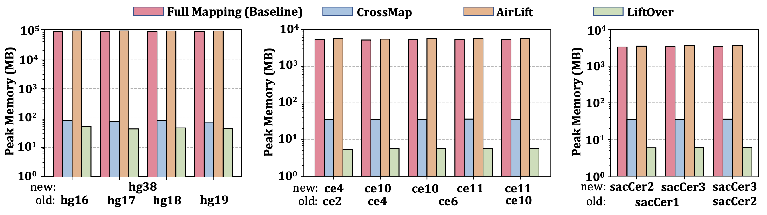
Peak Memory Usage
Peak memory usage similar to full mapping

Slide 30
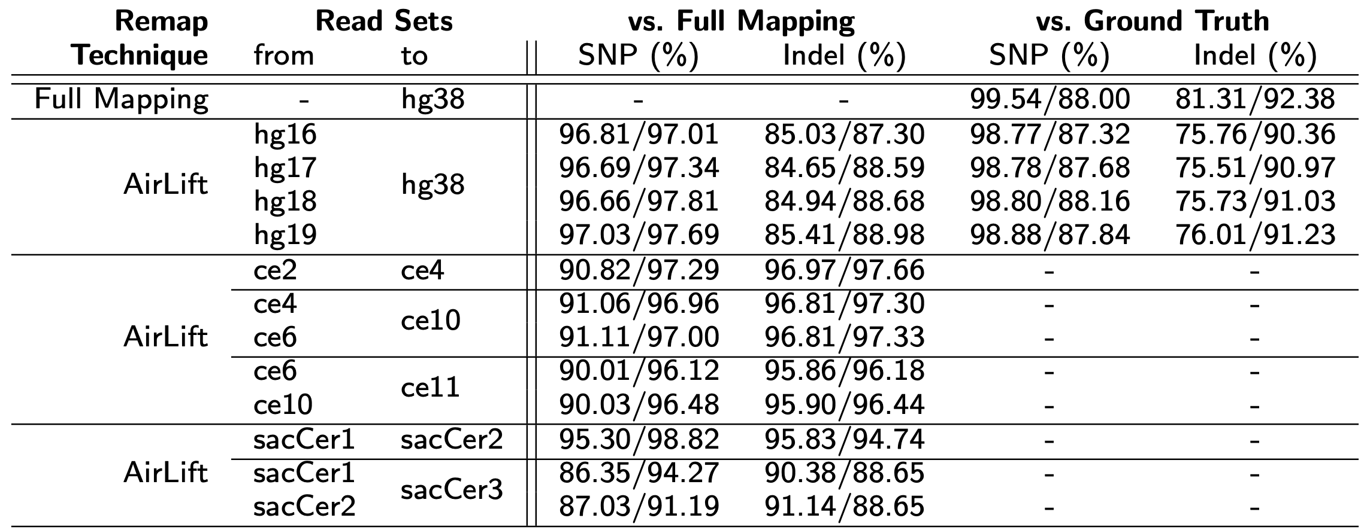
Accuracy – Variant Calling
Precision/Recall values compard to
Ground truth
Full mapping
Baseline:
Comparable accuracy to full mapping without the significant performance cost

Slide 31
Outline
Background
Motivation and Goal
Experimental Methodology
Temperature Analysis
Aggressor Row Active Time Analysis
Spatial Variation Analysis
Implications on Attacks and Defenses
Conclusions
Goal and Key Idea
AirLift
Evaluation
Conclusions

Slide 32
AirLift Summary
Problem | Remapping to a new reference genome is either costly (full mapping) or inaccurate (moving mapping positions)
Goal | Accurately and quickly remap all reads by either mapping or moving them from the old reference genome to the new reference genome
AirLift | AirLift Indexing: Accurately categorize and label each region in the old reference genome compared to the new reference genome AirLift Remapping: Remap a read to a new reference genome or Quickly move its position based on AirLift index
Key Results | AirLift consistently outperforms full mapping 2.6x – 6.7x speedup over full mapping AirLift identifies SNPs and INDELs with precision and recall similar to full mapping

Slide 33
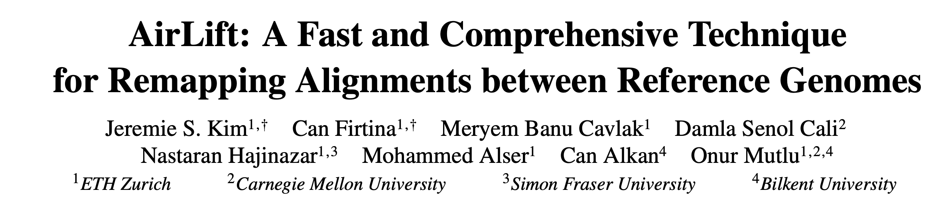
AirLift
Jeremie S. Kim, Can Firtina, Meryem Banu Cavlak, Damla Senol Cali, Nastaran Hajinazar, Mohammed Alser, Can Alkan, and Onur Mutlu, "AirLift: A Fast and Comprehensive Technique for Remapping Alignments between Reference Genomes" Preprint in arXiv and bioRxiv, 2022. [bioRxiv preprint] [arXiv preprint] [AirLift Source Code and Data]
bioRxiv Preprint

Slide 34
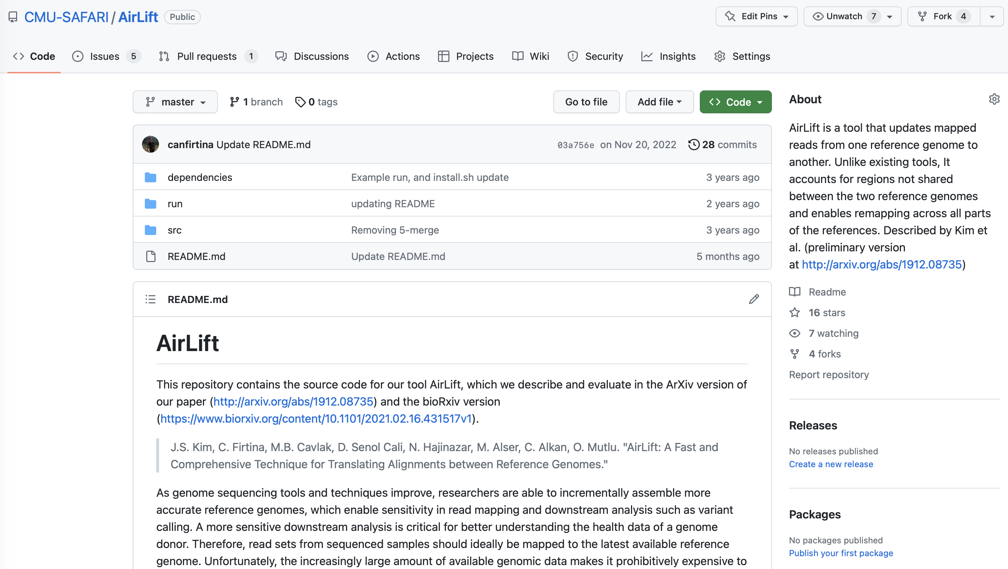
AirLift Source Code
Source Code
https://github.com/CMU-SAFARI/AirLift

Slide 35
AirLift A Fast and Comprehensive Technique for Remapping Alignments between Reference Genomes
Jeremie S. Kim*, Can Firtina*, Meryem Banu Cavlak, Damla Senol Cali,
Nastaran Hajinazar, Mohammed Alser, Can Alkan, and Onur Mutlu
bioRxiv Preprint
Source Code

Slide 36
Motivation and Goal
Experimental Methodology
Temperature Analysis
Aggressor Row Active Time Analysis
Spatial Variation Analysis
Implications on Attacks and Defenses
Conclusions
Backup Slides

Slide 37
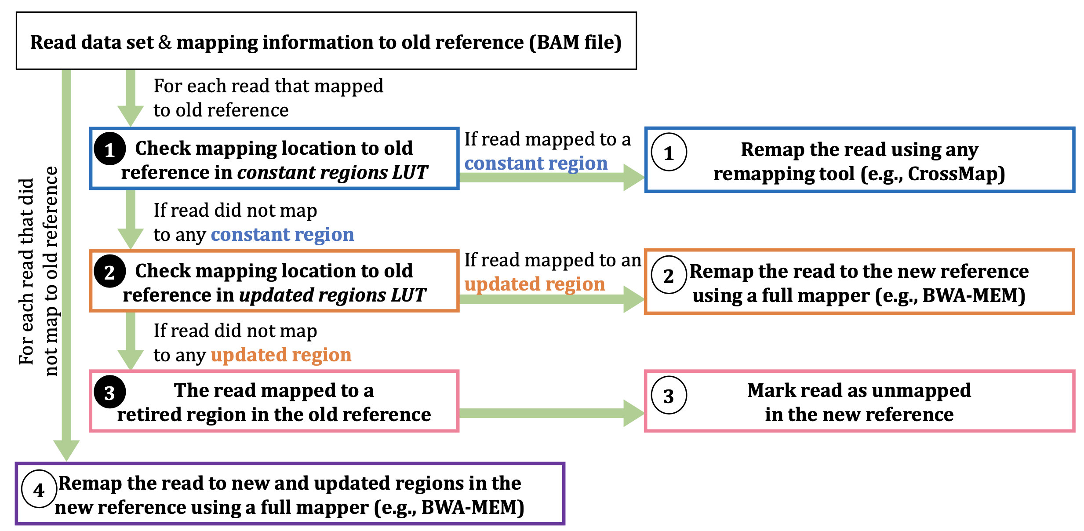
AirLift Remapping

